Slide 2
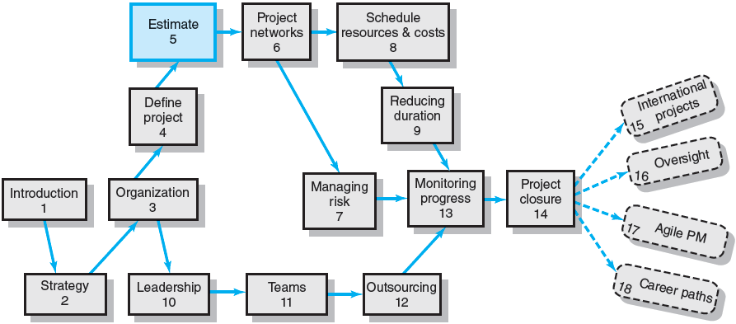
Where We Are Now

Slide 3
Chapter Objectives
To understand estimating project times and costs are the foundation for project planning and control
To have an awareness of the methods, uses, and advantages and disadvantages of top-down and bottom-up estimating methods
Be able to suggest estimating guidelines for time, cost, and resources
To suggest a scheme for developing an estimating database for future projects.

Slide 4
Project estimation is indeed a yardstick for project cost control. And if the yardstick is faulty, you start on the “wrong foot.” . . . we exhort you not to underestimate the estimate.
O. P. Kharbanda and J. K. Pinto. What Made Gertie Gallop: Learning from Project Failures (New York: Von Nostrand Reinhold, 1996), p 73.

Slide 5
Estimating Projects
Estimating
The process of forecasting or approximating the time and cost of completing project deliverables.
The task of balancing expectations of stakeholders and need for control while the project is implemented.
Types of Estimates
Top-down (macro) estimates: analogy, group consensus, or mathematical relationships
Bottom-up (micro) estimates: estimates of elements of the work breakdown structure

Slide 6
Why Estimating Time and Cost Are Important
To support good decisions.
To schedule work.
To determine how long the project should take and its cost.
To determine whether the project is worth doing.
To develop cash flow needs.
To determine how well the project is progressing.
To develop time-phased budgets and establish the project baseline.
EXHIBIT 5.1

Slide 7
Factors Influencing the Quality of Estimates
Planning Horizon
Other (Nonproject) Factors
Project Duration
Quality of Estimates
Organization Culture
People
Padding Estimates
Project Structure and Organization

Slide 8
Developing Work Package Estimates
Use people familiar with the tasks
Include a risk assessment
Use several people to make estimates
Preparing Initial Estimates
Make no allowance for contingencies
Assume normal conditions
Assume tasks are independent
Use consistent time units

Slide 9
Estimating Guidelines for Times, Costs, and Resources
Have people familiar with the tasks make the estimate.
Use several people to make estimates.
Base estimates on normal conditions, efficient methods, and a normal level of resources.
Use consistent time units in estimating task times.
Treat each task as independent, don’t aggregate.
Do not make allowances for contingencies.
Add a risk assessment to avoid surprises to stakeholders.

Slide 10
Top-Down versus Bottom-Up Estimating
Top-Down Estimates
Are usually derived from someone who uses experience and/or information to determine the project duration and total cost.
Are made by top managers who have little knowledge of the processes used to complete the project.
Bottom-Up Approach
Can serve as a check on cost elements in the WBS by rolling up the work packages and associated cost accounts to major deliverables at the work package level.

Slide 11
Top-Down versus Bottom-Up Estimating
Conditions for Preferring Top-Down or Bottom-up Time and Cost Estimates
Top-down Bottom-up Condition Estimates Estimates
Strategic decision making X
Cost and time important X
High uncertainty X
Internal, small project X
Fixed-price contract X
Customer wants details X
Unstable scope X
TABLE 5.1

Slide 12
Estimating Projects: Preferred Approach
Make rough top-down estimates.
Develop the WBS/OBS.
Make bottom-up estimates.
Develop schedules and budgets.
Reconcile differences between top-down and bottom-up estimates

Slide 13
Top-Down Approaches for Estimating Project Times and Costs
Consensus methods
Ratio methods
Apportion method
Function point methods for software and system projects
Learning curves
Project Estimate Times Costs

Slide 14
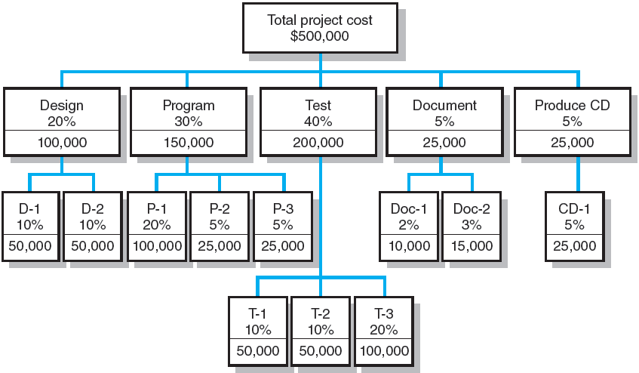
Apportion Method of Allocating Project Costs Using the Work Breakdown Structure
FIGURE 5.1

Slide 15
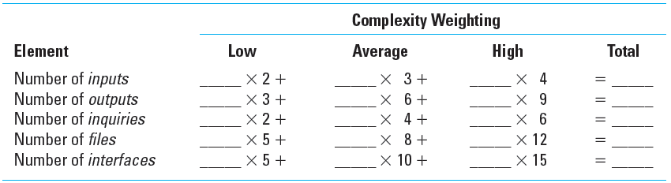
Simplified Basic Function Point Count Process for a Prospective Project or Deliverable
TABLE 5.2

Slide 16
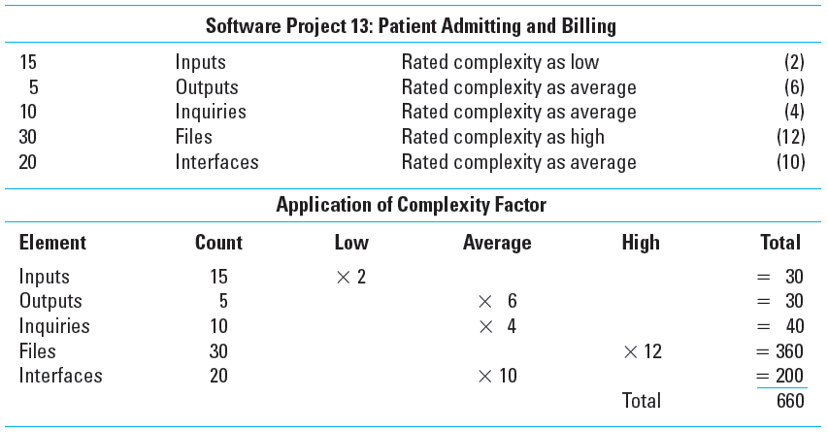
Example: Function Point Count Method
TABLE 5.3

Slide 17
Bottom-Up Approaches for Estimating Project Times and Costs
Template methods
Parametric procedures applied to specific tasks
Range estimates for the WBS work packages
Phase estimating: A hybrid

Slide 18
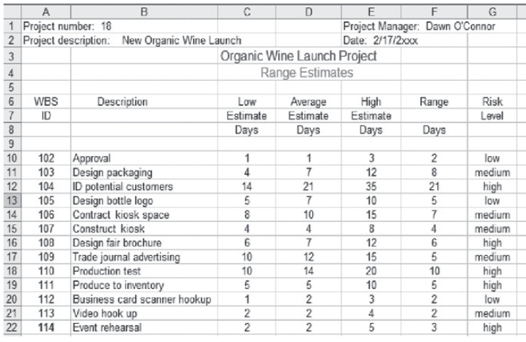
Range Estimating Template
FIGURE 5.2

Slide 19
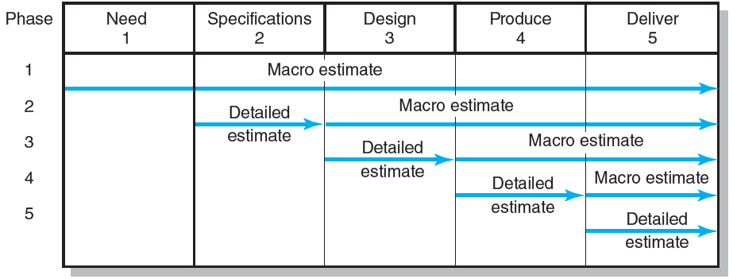
Phase Estimating over Product Life Cycle
FIGURE 5.3

Slide 20
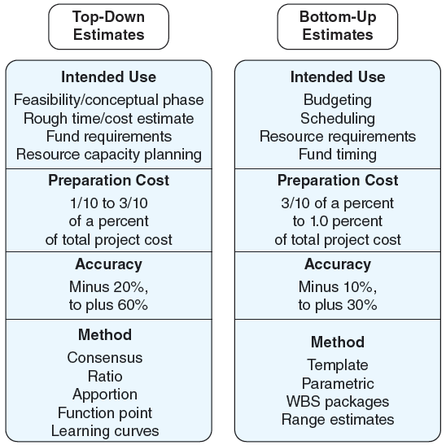
Top-Down and Bottom-Up Estimates
FIGURE 5.4

Slide 21
Level of Detail
Level of detail is different for different levels of management.
Level of detail in the WBS varies with the complexity of the project.
Excessive detail is costly.
Fosters a focus on departmental outcomes
Creates unproductive paperwork
Insufficient detail is costly.
Lack of focus on goals
Wasted effort on nonessential activities

Slide 22
Types of Costs
Direct Costs
Costs that are clearly chargeable to a specific work package.
Labor, materials, equipment, and other
Direct (Project) Overhead Costs
Costs incurred that are directly tied to an identifiable project deliverable or work package.
Salary, rents, supplies, specialized machinery
General and Administrative Overhead Costs
Organization costs indirectly linked to a specific package that are apportioned to the project

Slide 23
Contract Bid Summary Costs
Direct costs | $80,000
Direct overhead | $20,000
Total direct costs | $100,000
G&A overhead (20%) | $20,000
Total costs | $120,000
Profit (20%) | $24,000
Total bid | $144,000
FIGURE 5.5

Slide 24
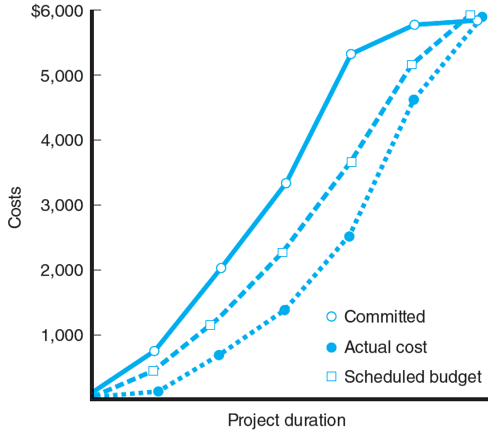
Three Views of Cost
FIGURE 5.6

Slide 25
Refining Estimates
Reasons for Adjusting Estimates
Interaction costs are hidden in estimates.
Normal conditions do not apply.
Things go wrong on projects.
Changes in project scope and plans.
Adjusting Estimates
Time and cost estimates of specific activities are adjusted as the risks, resources, and situation particulars become more clearly defined.

Slide 26
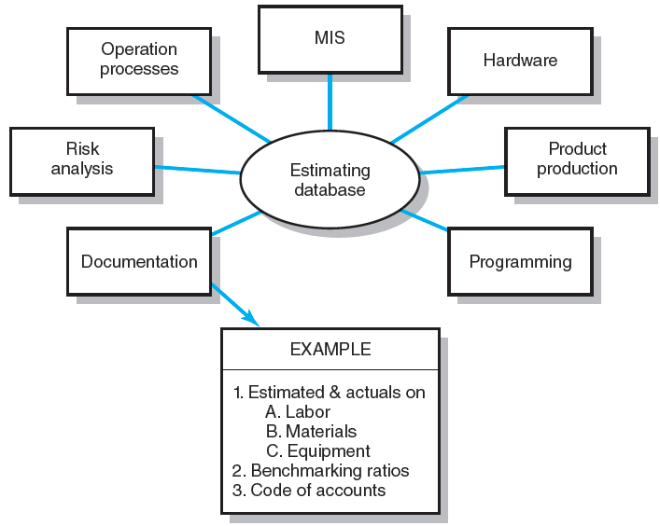
Estimating Database Templates
FIGURE 5.7

Slide 27
Key Terms
Apportionment methods
Bottom-up estimates
Contingency funds
Delphi method
Direct costs
Function points
Learning curves
Overhead costs
Padding estimates
Phase estimating
Range estimating
Ratio methods
Template method
Time and cost databases

Slide 28
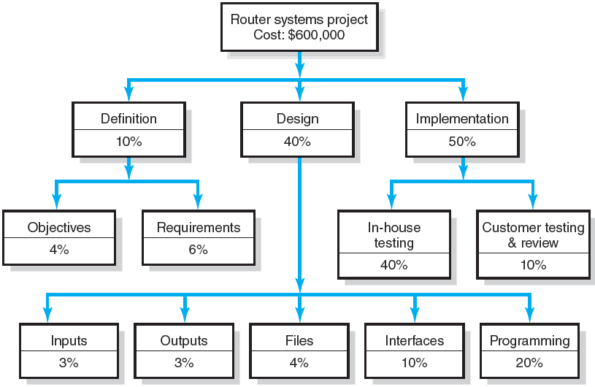
WBS Figure
Exercise 5.3

Slide 29
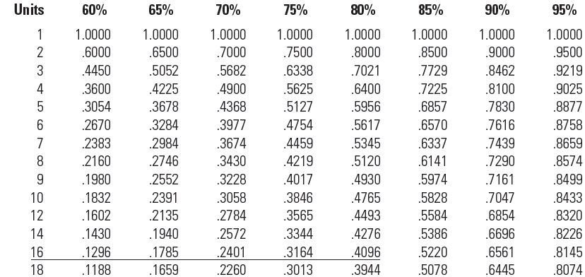
Learning Curves Unit Values
TABLE A5.1

Slide 30
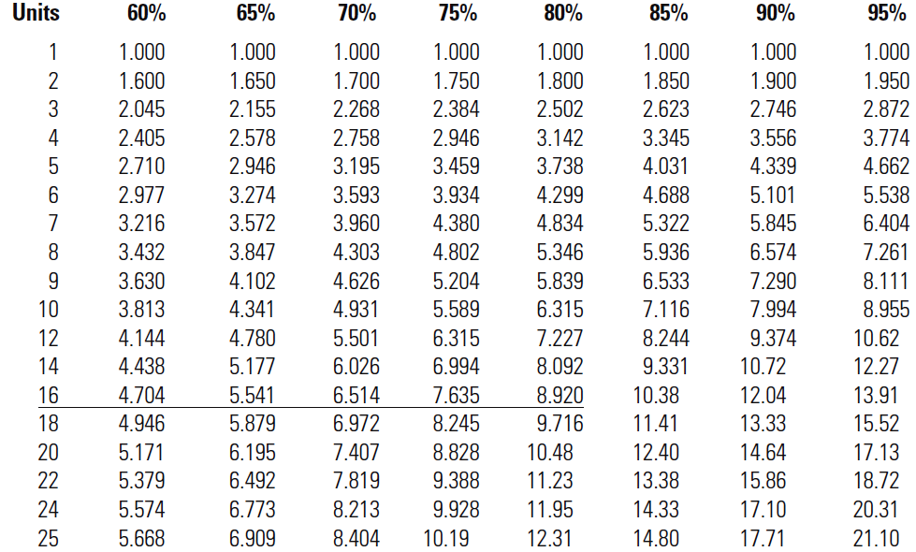
Learning Curves Cumulative Values
TABLE A5.2

